Slide 1
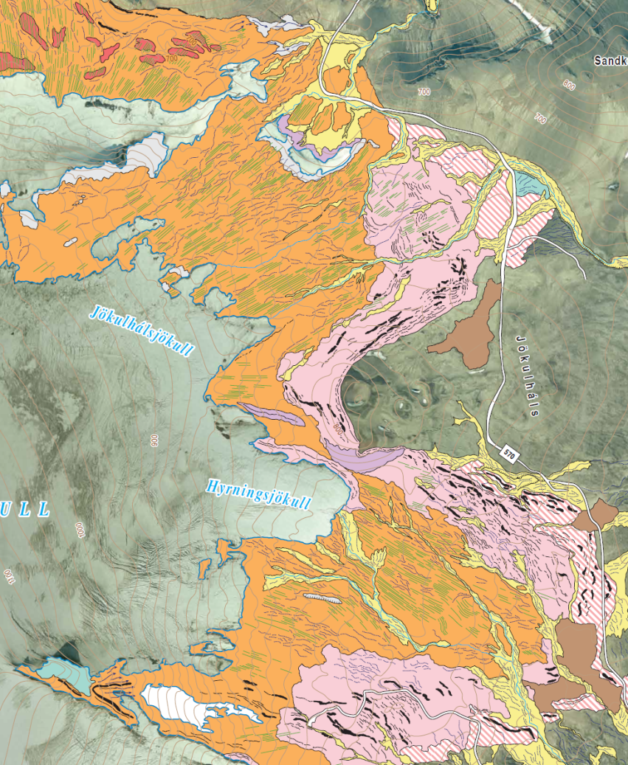
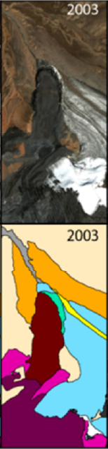
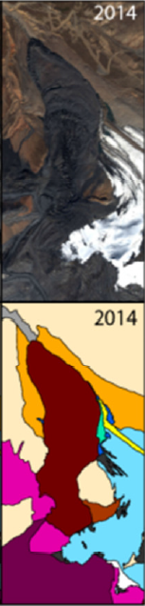


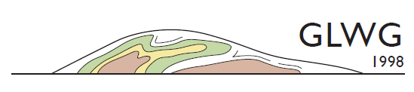

Mapping surficial geology and geomorphology in landscapes undergoing rapid deglaciation
(lessons for understanding Quaternary glacial geology)
David J A Evans

Slide 2
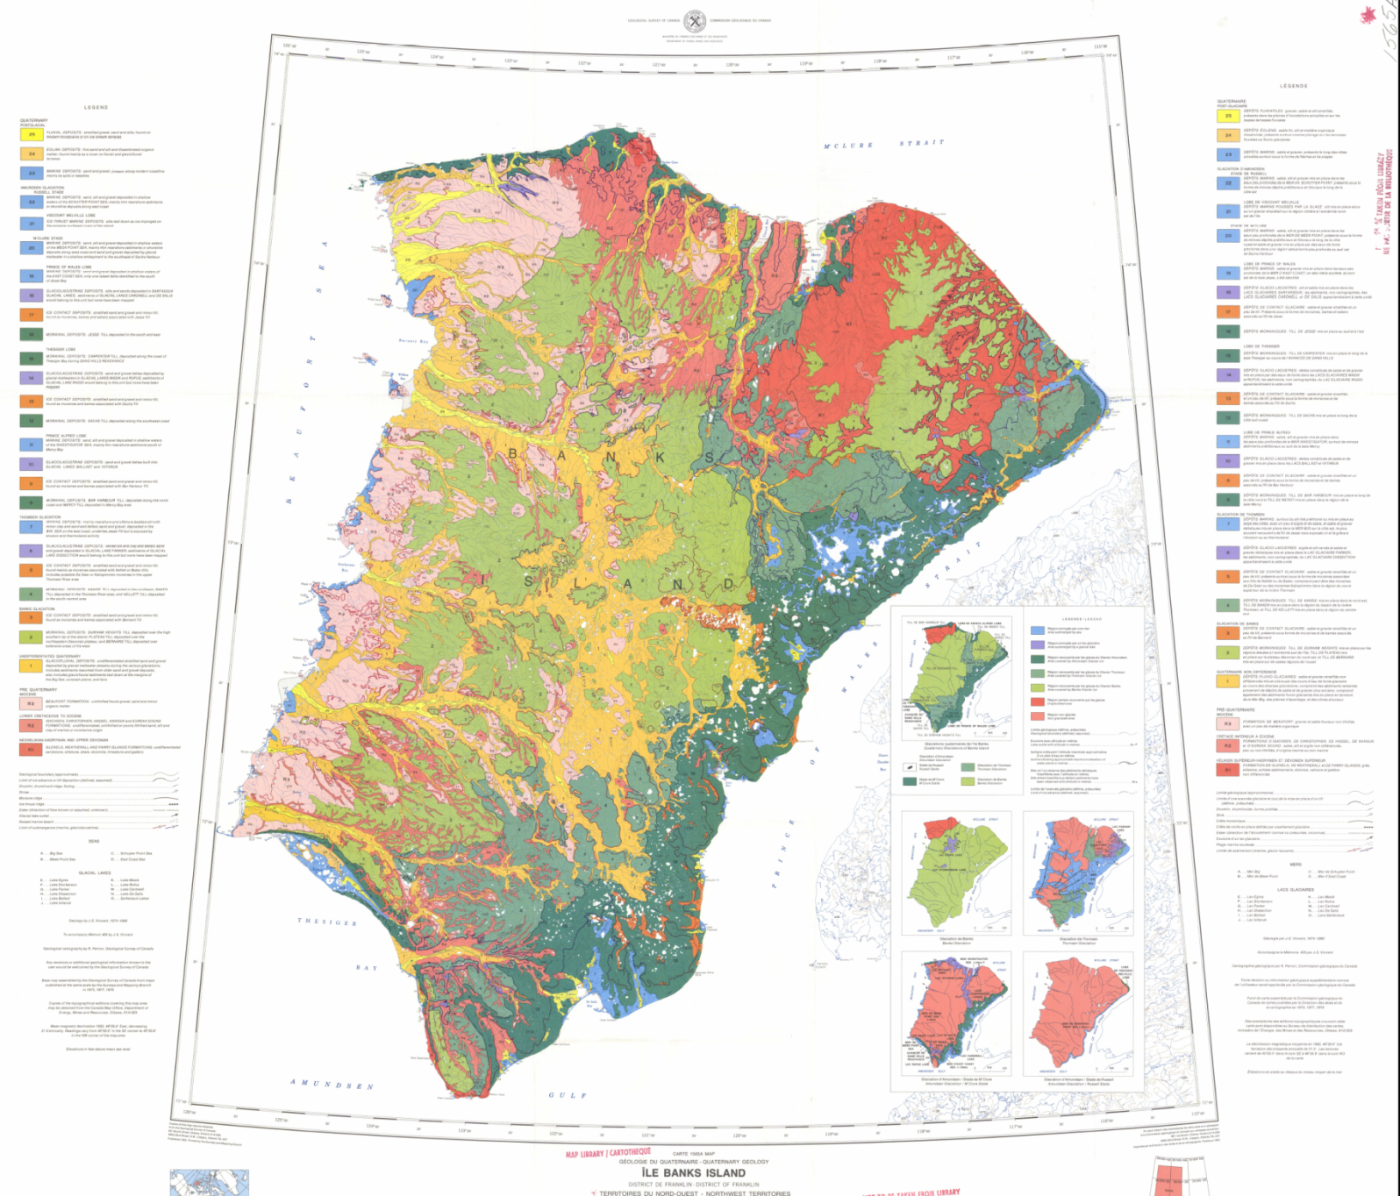
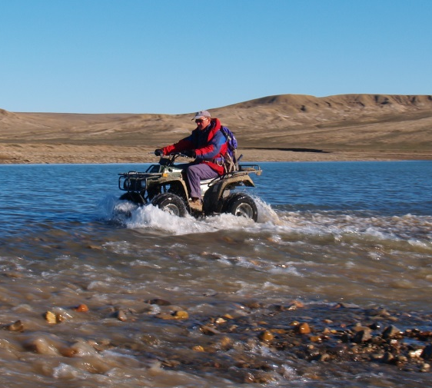
Quaternary geology – a Canadian perspective
(because that’s where I learned my craft!)
Compilation of database of earth surface materials
(intensive aerial photograph analysis)
= maps (surficial geology + genetic classifications)
= stratigraphies (sub- surface complexities)

Slide 3
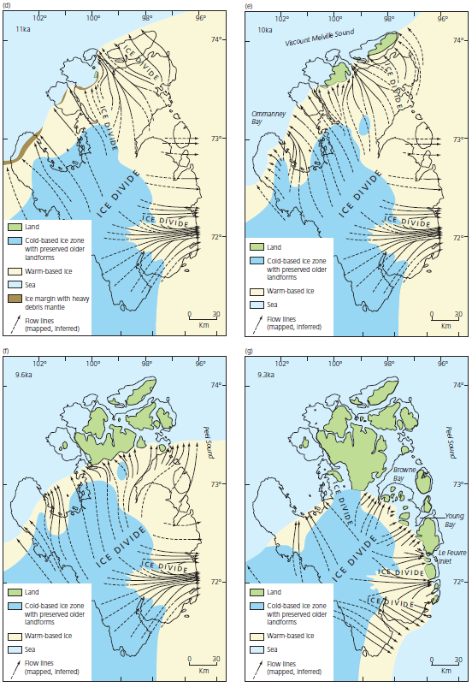
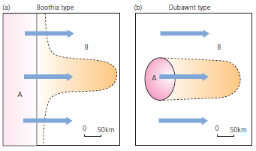
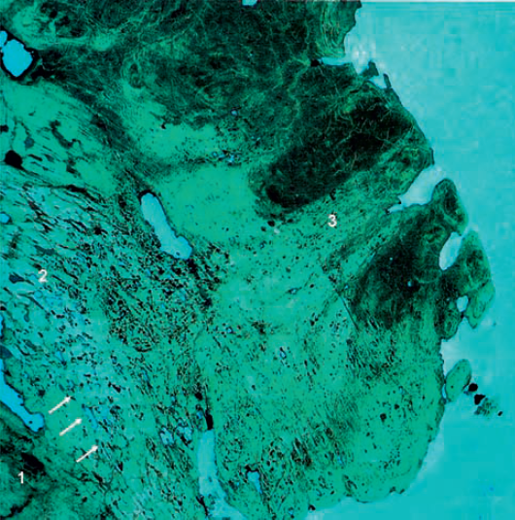
What did Canadian Quaternary glacial geology do well?
Identified process-form regimes & acknowledged spatial & temporal complexity
⇒ Major conceptual breakthroughs in glacial
geology &
geomorphology
e.g. cross-cutting subglacial bedforms
& palaeo-ice streams
+ cold-based v warm-based ice
(Dyke & Morris 1988)

Slide 4
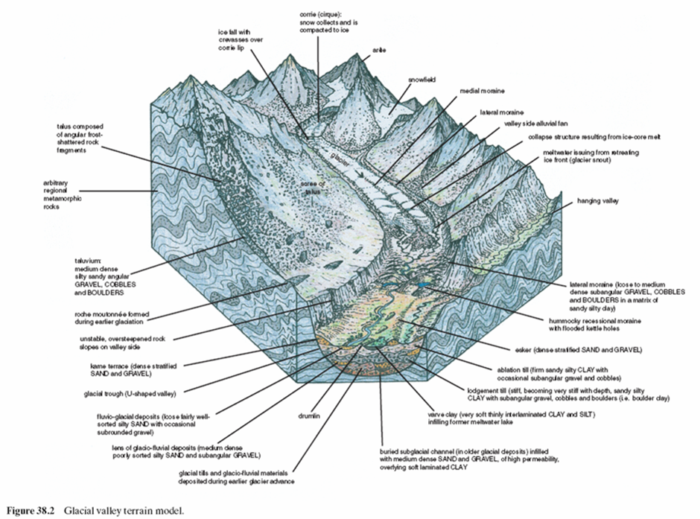
Engineering “ground model” (Fookes et al. 2007)
– the impoverished glacial ground model
- glacial valley terrain
- periglacial terrain
- semi-arid & temperate terrain
- Mediterranean terrain
- desert terrain
- savannah terrain
- wet tropical terrain
- mountain terrain
Problems in glaciated basins
- no variety in glaciated terrain types (i.e. lowland, plateau)
- no account of huge sedimentological and stratigraphic complexities
(i.e. style & pattern of glaciation)
- a serious need to incorporate significant advances in glacial sedimentology &
mapping spatial variability of process-form regimes

Slide 5
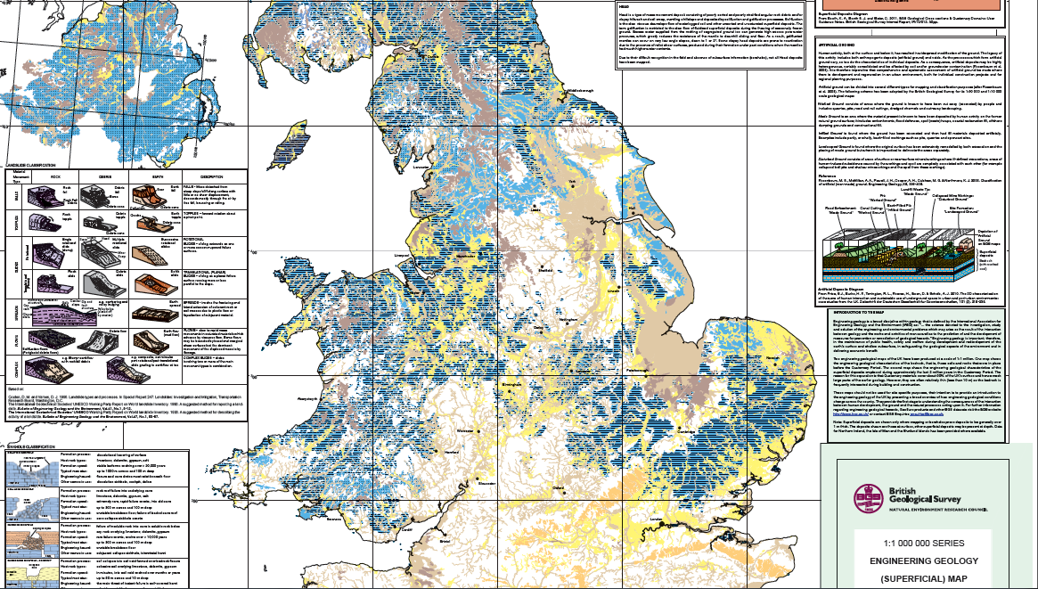
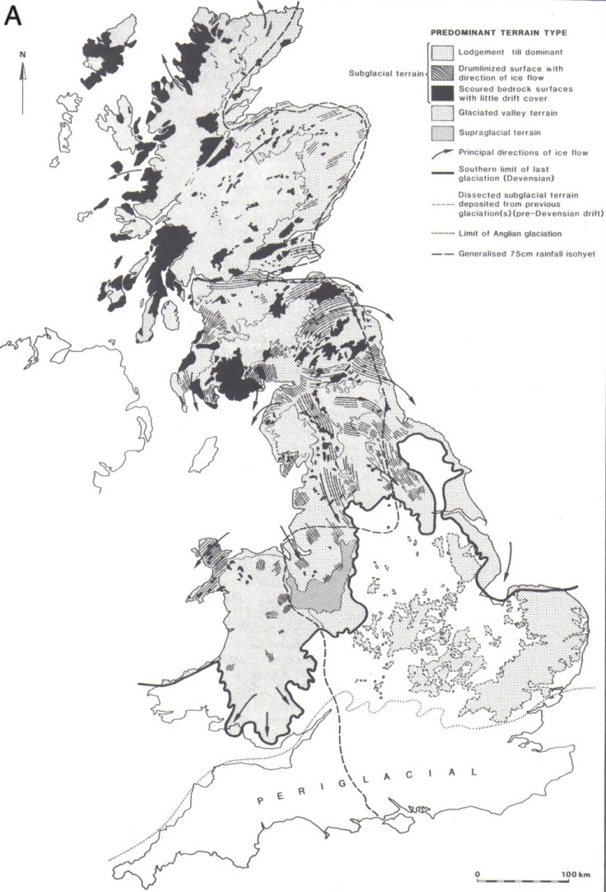
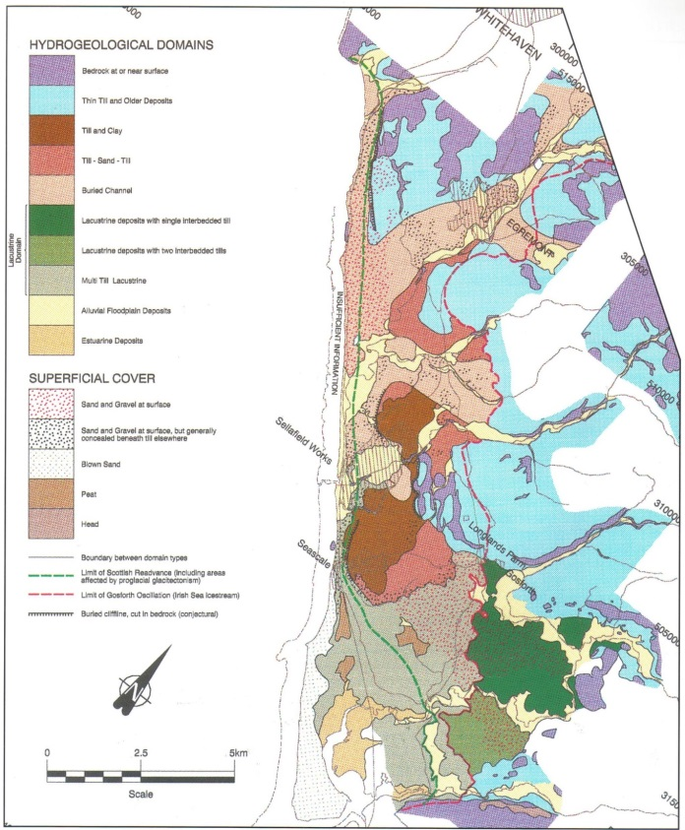
Complexity beyond the glaciated valley model for glaciation
Eyles & Dearman 1981
NIREX 1997

Slide 6
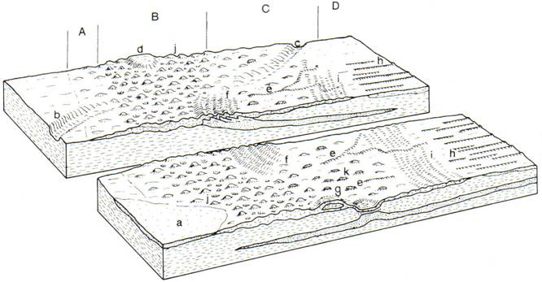
Glacial landsystems – acknowledging variety
Landsystem: area of common terrain attributes, different from those of adjacent areas, in which recurring patterns of topography, soils & vegetation reflect the underlying geology, past erosional & depositional processes, & climate
Eyles (1983) – Glacial Geology
Clayton & Moran (1974)
– the original process-
form model

Slide 7
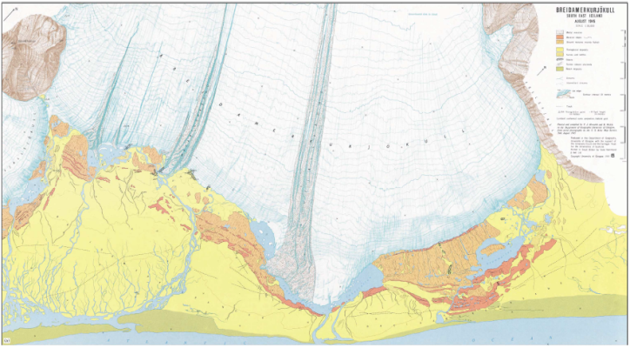
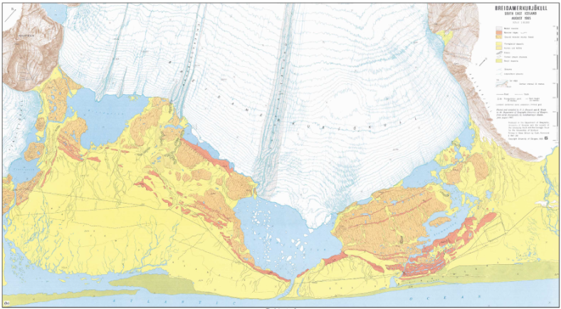
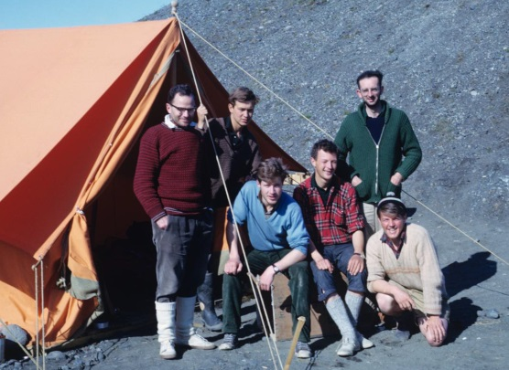
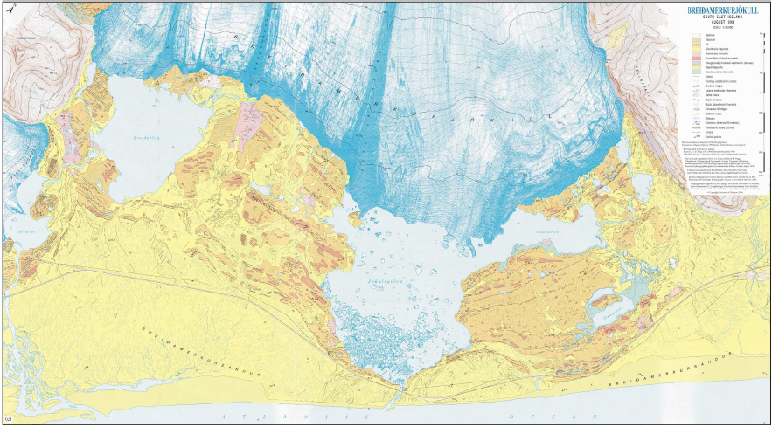
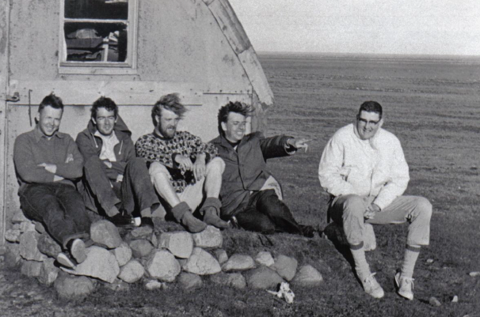
Process-form models: modern analogues
The Breiðamerkurjökull legacy

Slide 8
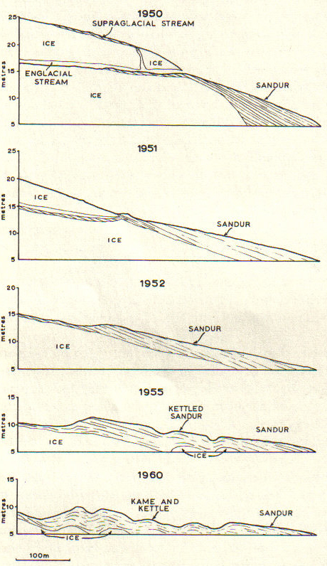
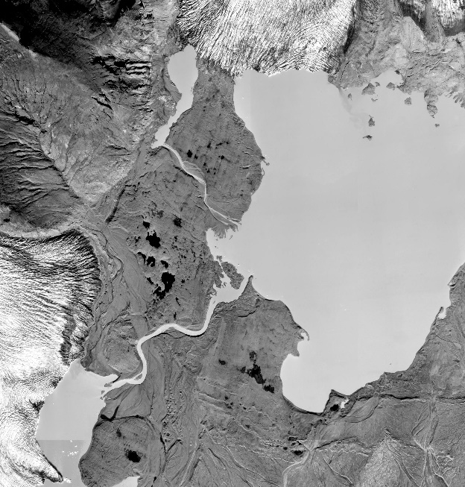
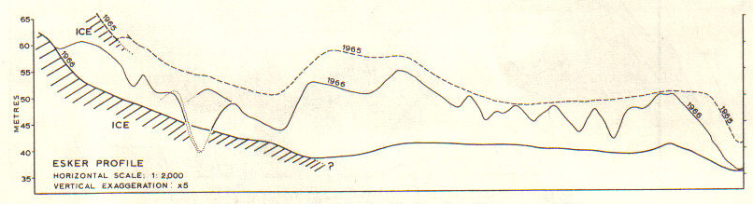
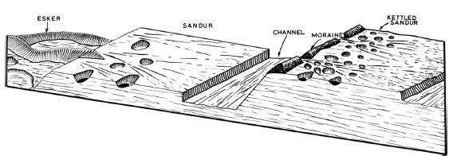
Process-form models – modern analogues
The Breiðamerkurjökull legacy
Process–form model - conceptual model that emphasizes the genetic interrelationships of specific landform– sediment associations at both local & regional scales in terms of known process & form linkages
First process-form model from modern glacier margin?
- Price (1969),
Breiðamerkurjökull, Iceland

Slide 9
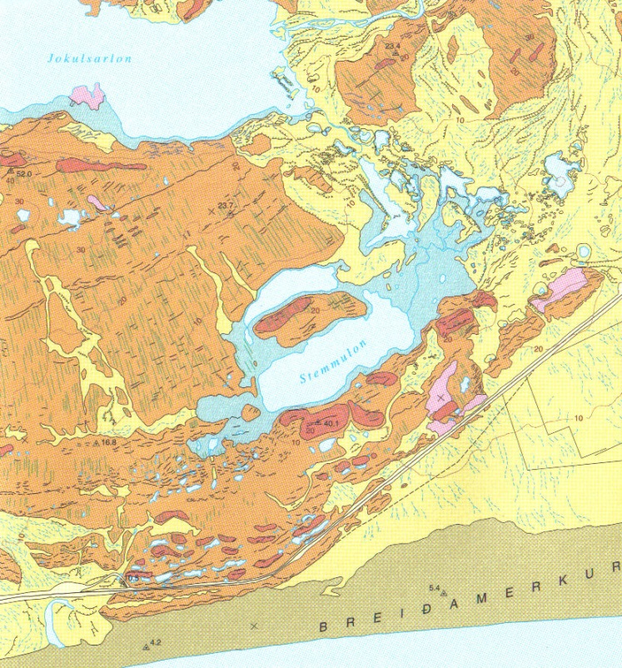
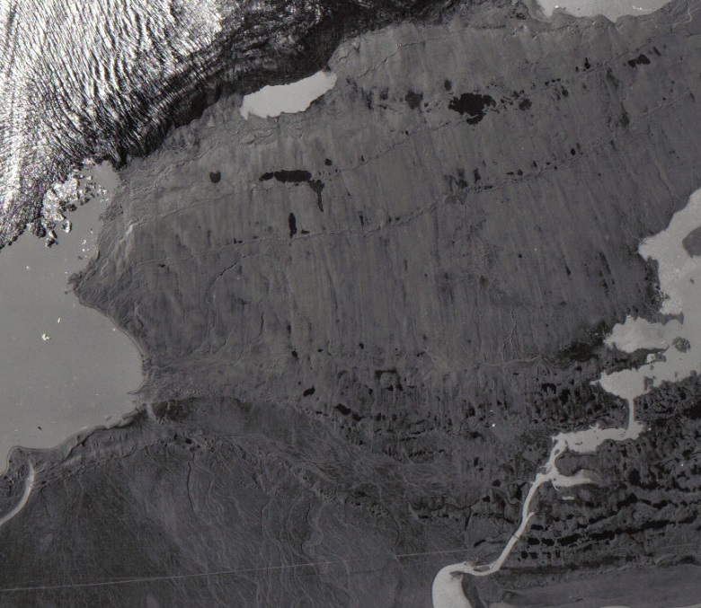
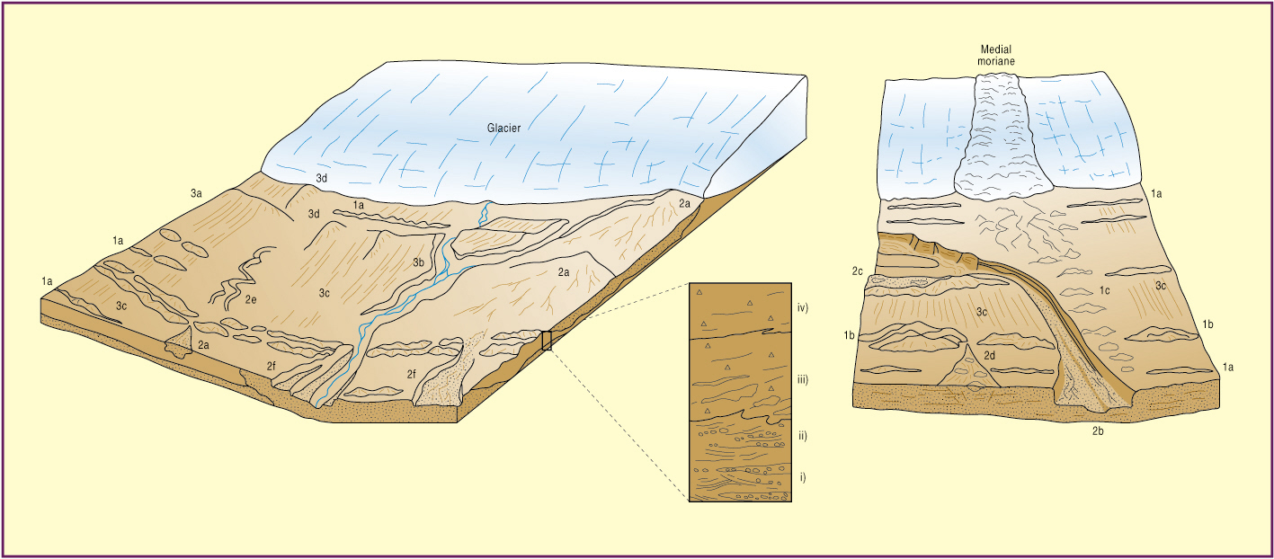
Process-form models - Icelandic active temperate glaciers
Depositional domains (diagnostic landform-sediment associations) =
1) Marginal morainic; 2) Glacifluvial & glacilacustrine; 3) Subglacial

Slide 10
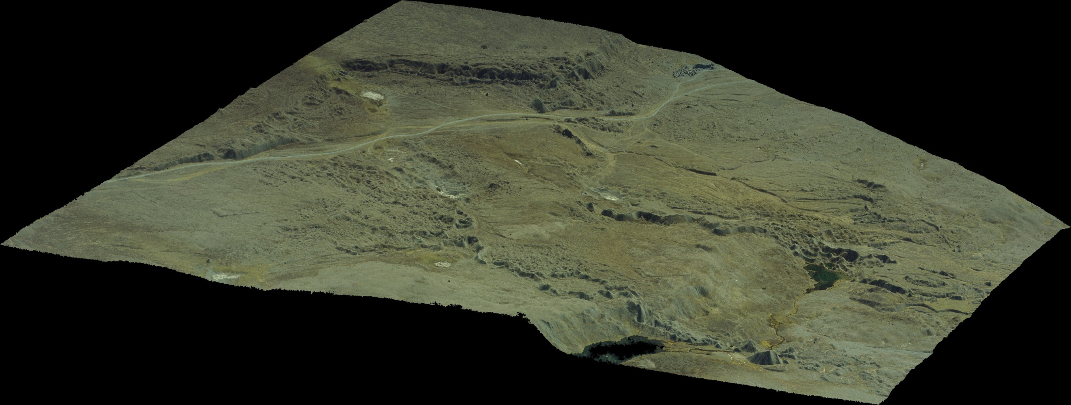
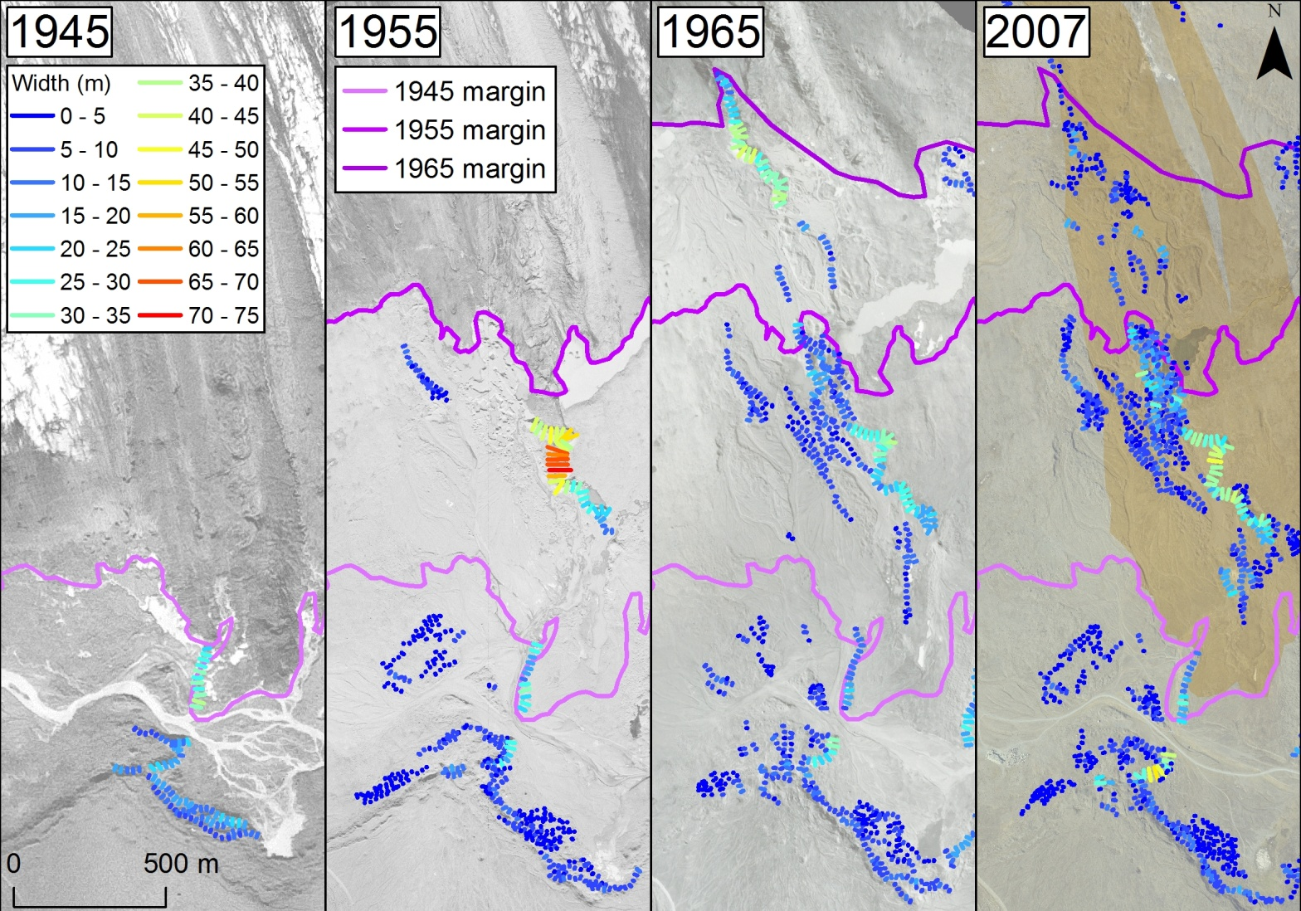
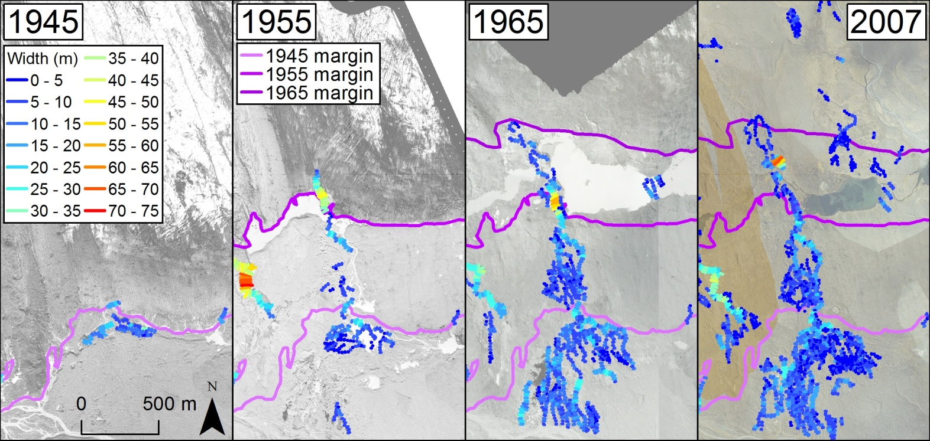
Process-form models - The development of eskers through time
MES 1
MES 2

Slide 11
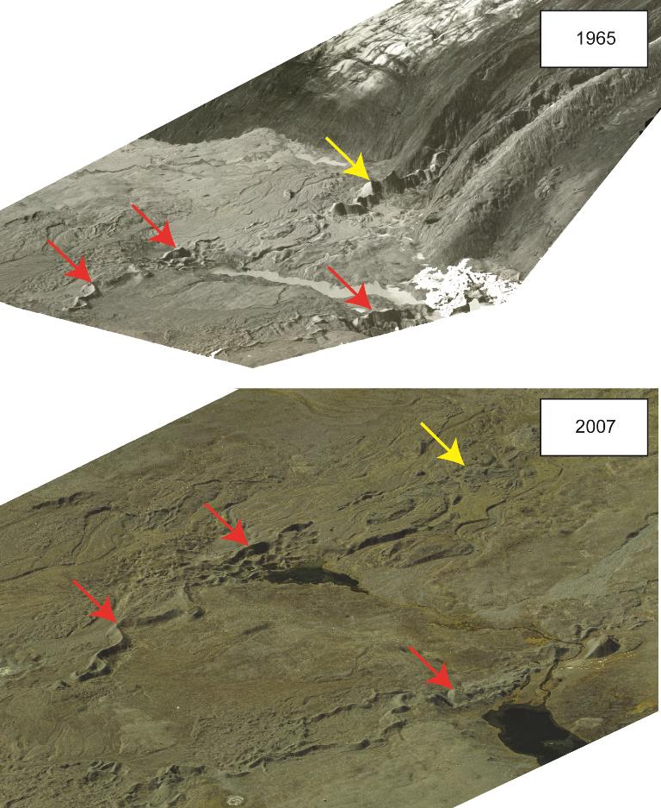
The development of eskers through time
1965: esker melting out of Mavabyggdarond medial moraine (yellow arrow)
2007: this esker appears to have decreased in size relative to the more distal eskers (red arrows)
So it was a proto-esker in 1965 with poor preservation potential
(confirms Price’s 1969
ice core predictions)

Slide 12
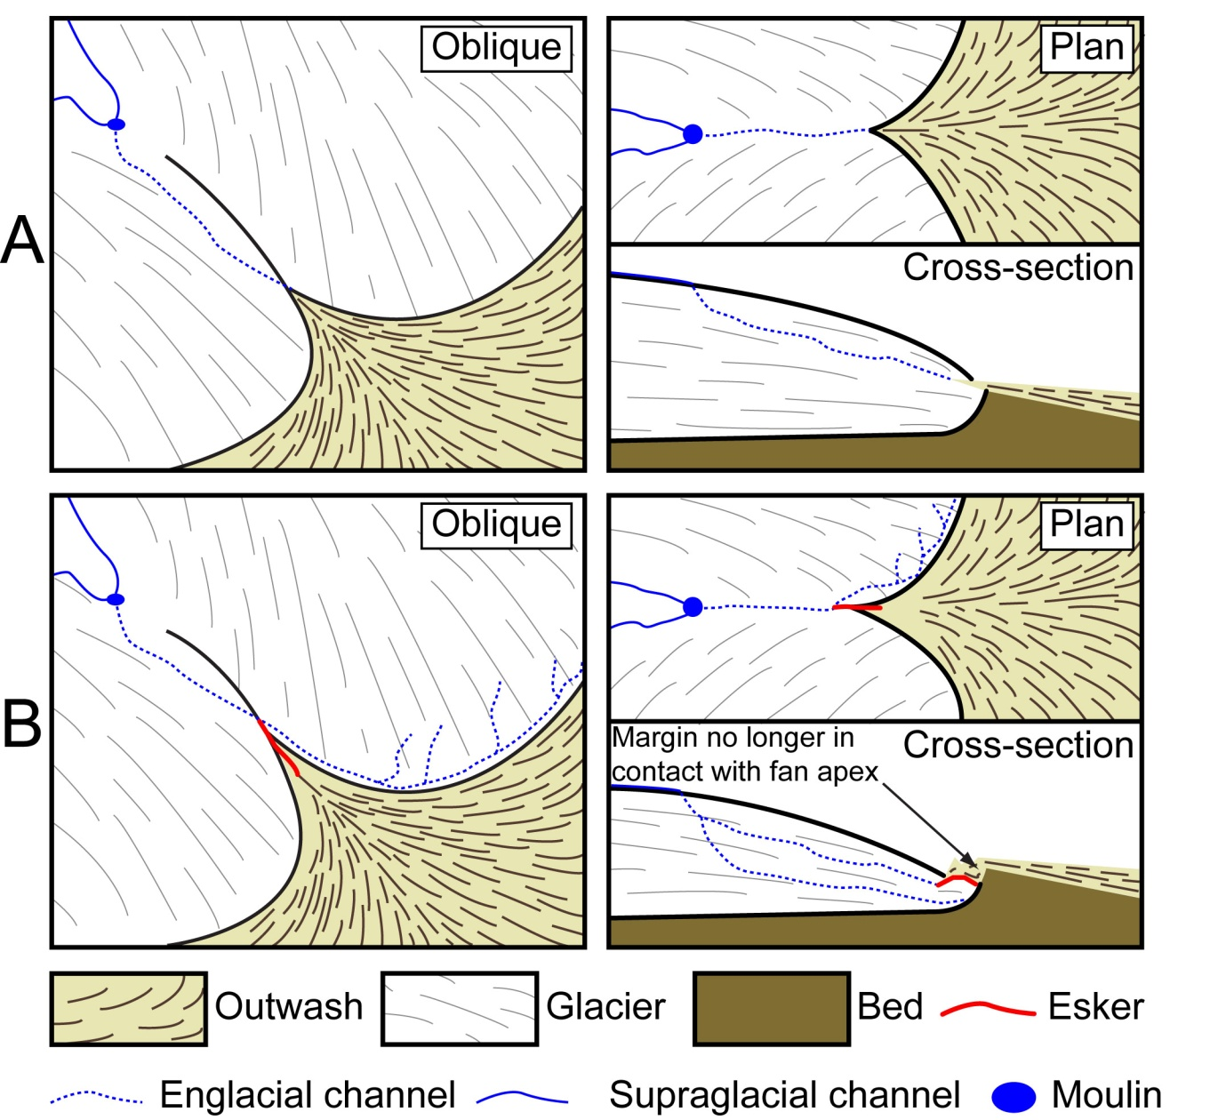

The development of eskers through time
Models of esker formation (MES 1)
Models of esker formation (MES 1)
englacial stream feeds ice-contact fan
glacier surface lowers during retreat & drainage is impeded by the fan. So meltwater is diverted along the apex of the fan, where eskers then form

Slide 13
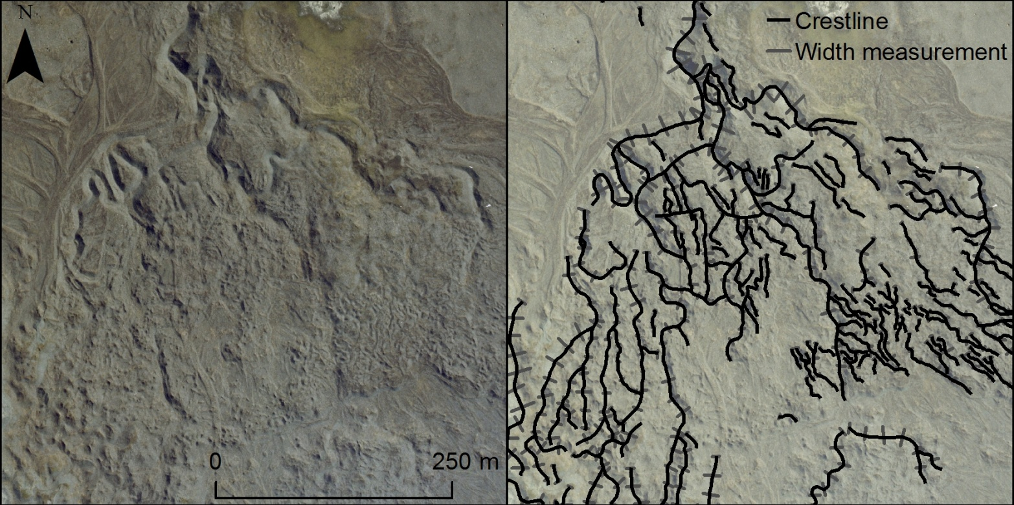
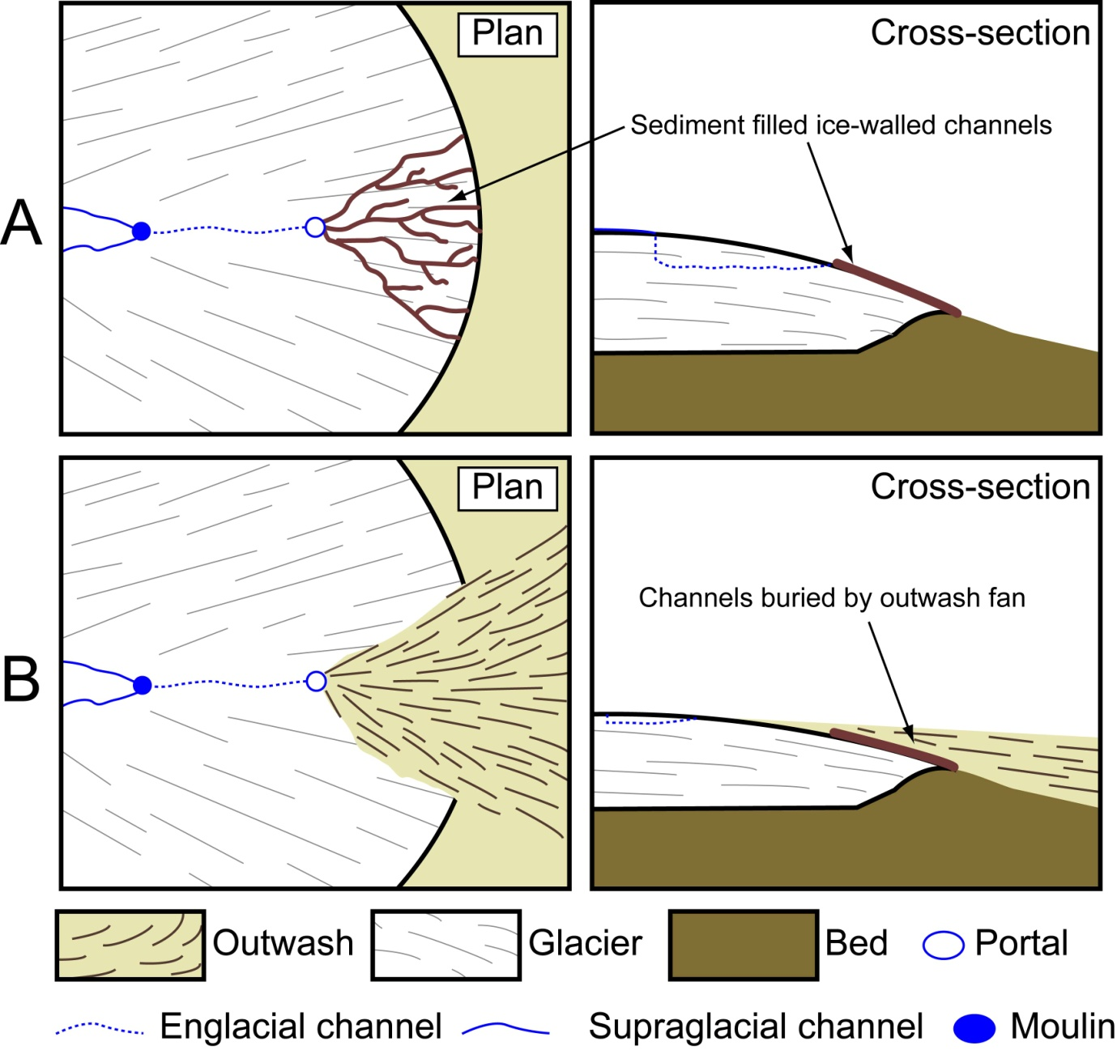
The development of eskers through time
    Models of esker formation (MES 2)
englacial stream emerges on glacier surface & water drains in supraglacial channels to form eskers
outwash fan aggrades over the snout & eskers. Eskers then emerge as the ice melts out

Slide 14
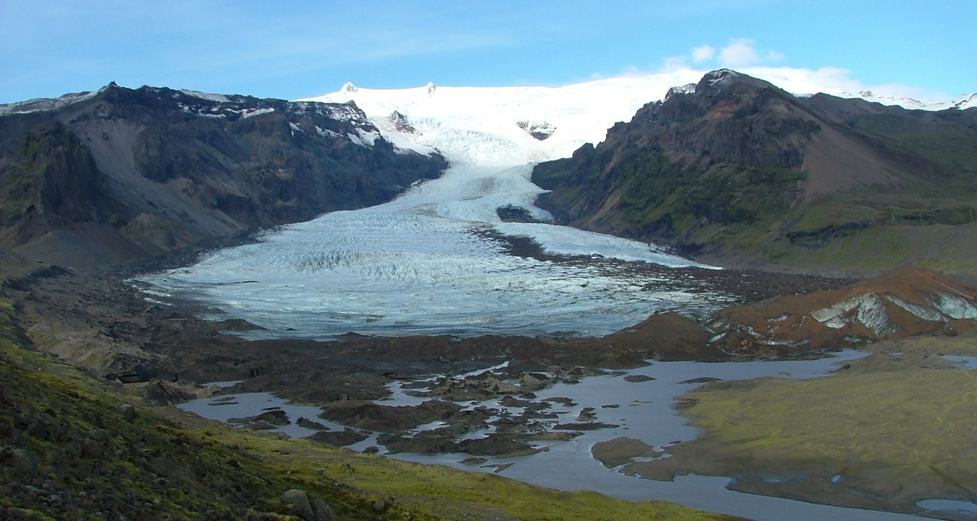
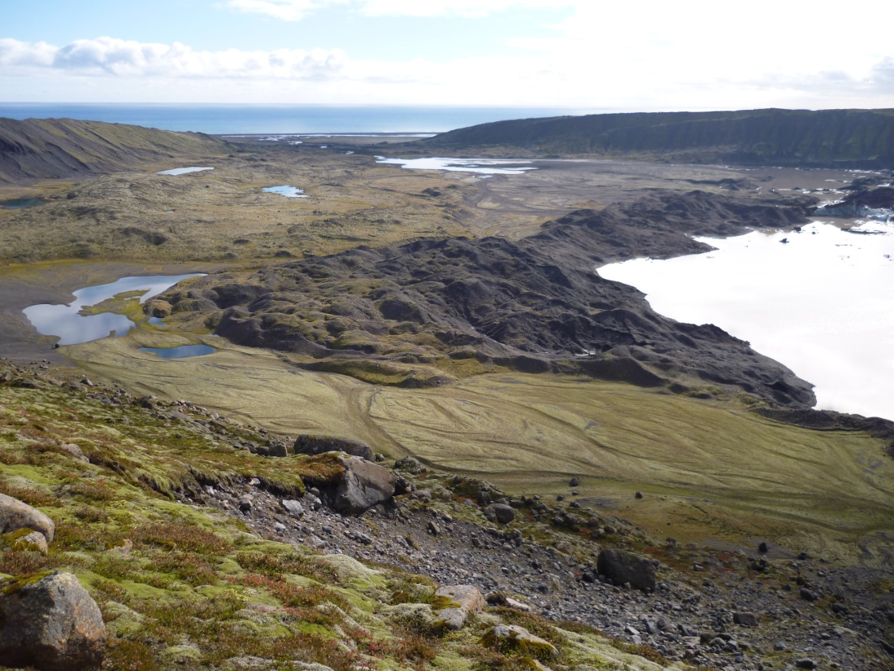
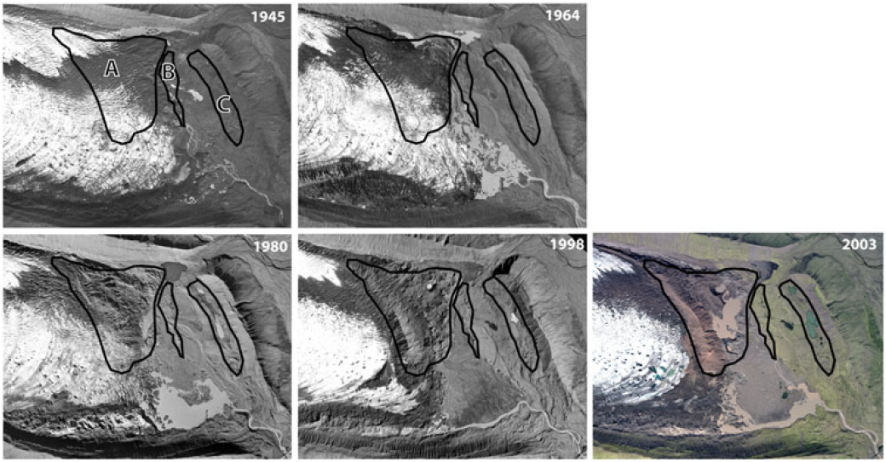
Process-form models: Kvíárjökull - an overdeepening in the act of revealing itself
Photogrammetric survey - piedmont lobe with overdeepening & associated ice-cored moraine
Englacial eskers =
drainage bypassing
the overdeepening
Kame terrace forming inside lateral moraine
Hummocky (controlled) moraine & incremental stagnation

Slide 15
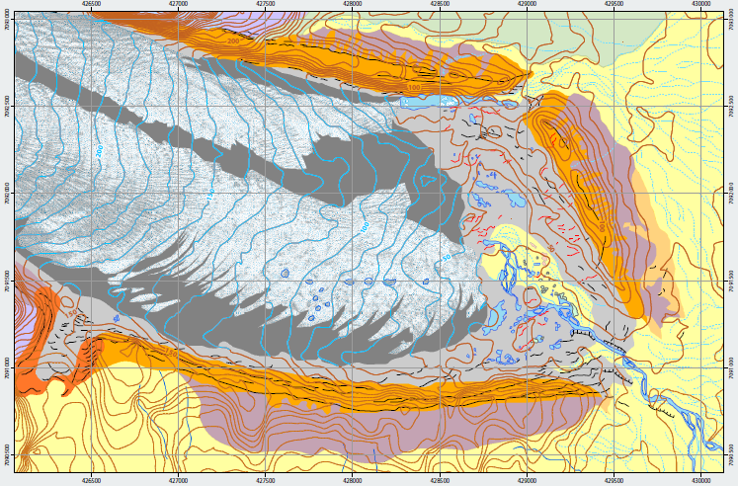
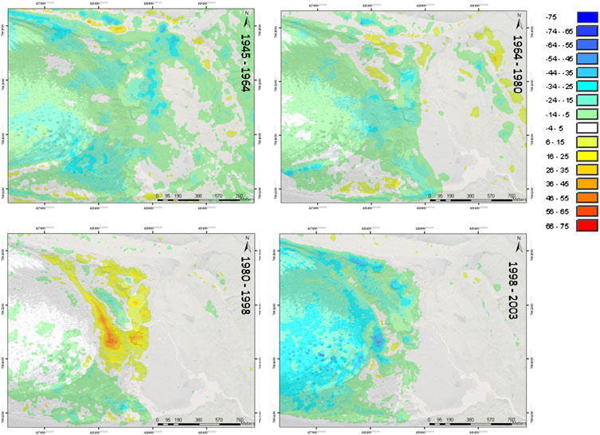
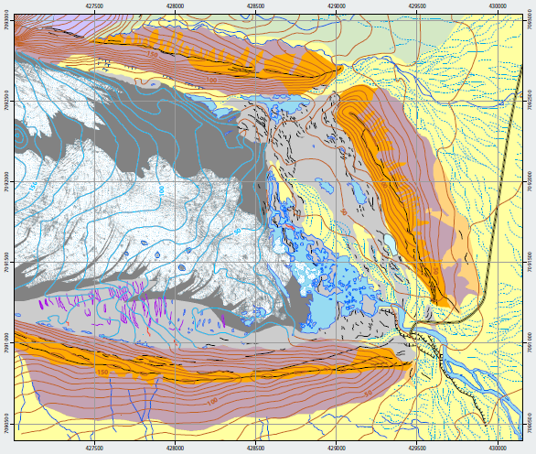
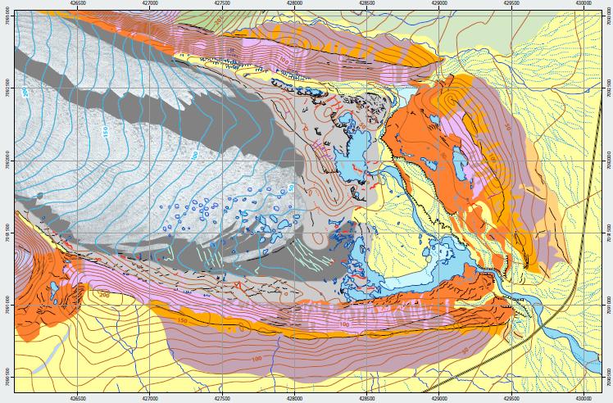
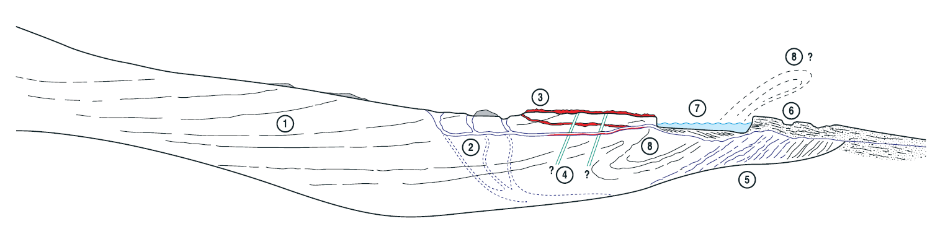
1945
1964
Incremental stagnation (Eyles 1983)
– active temperate glaciodynamics
of debris-covered snout
2003

Slide 16
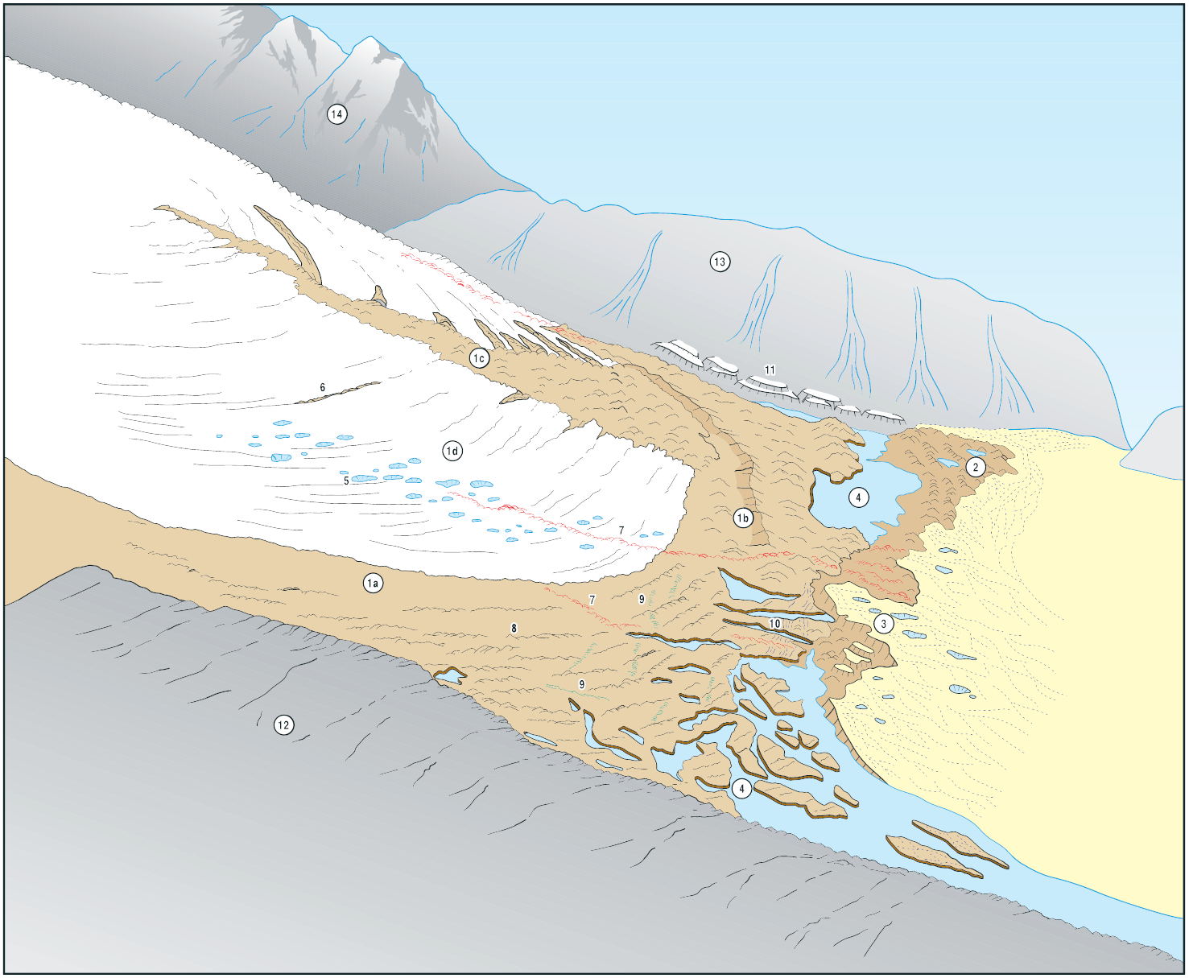
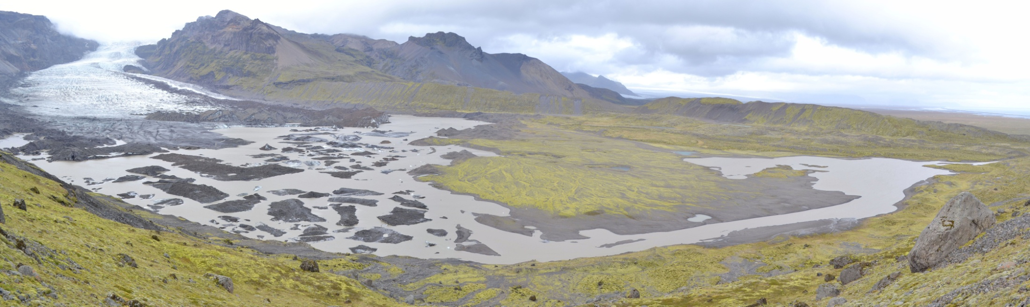
Kvíárjökull - an overdeepening in the act of revealing itself
Analogue for outwash head-
dammed overdeepening
(typical topographic scenario
for upland landscapes)

Slide 17
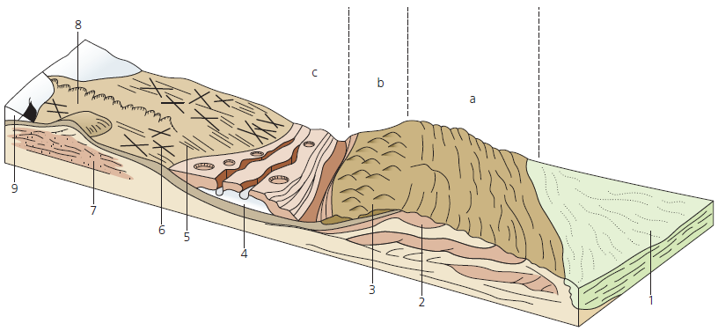
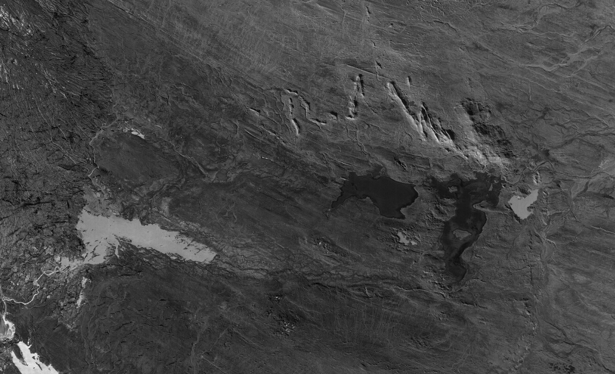
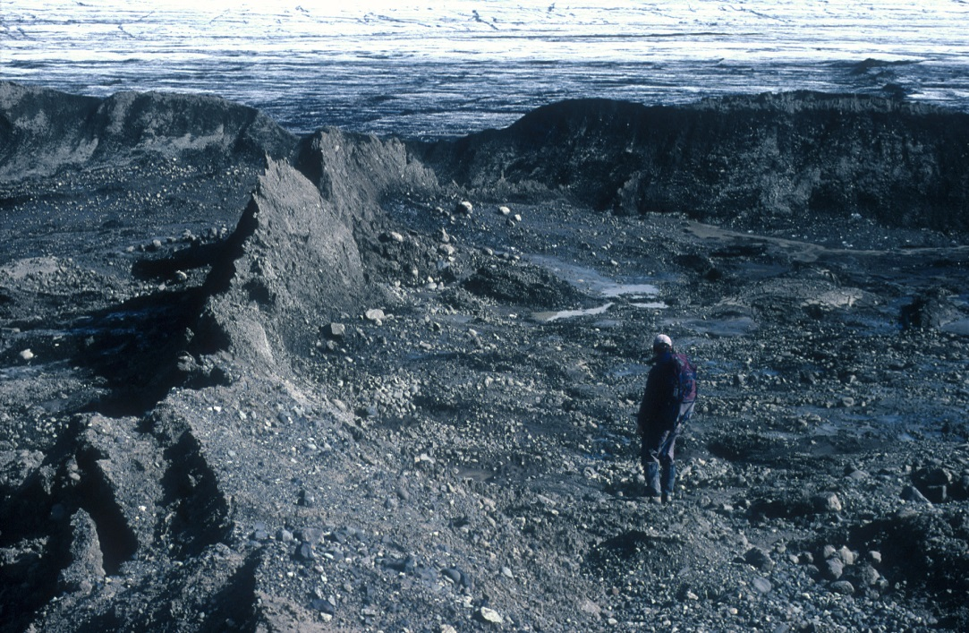
Process-form models: surging glaciers
Evans & Rea 1999, 2003
Crevasse squeeze ridges
Zig-zag eskers

Slide 18
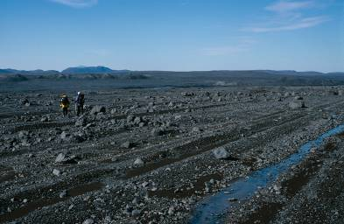
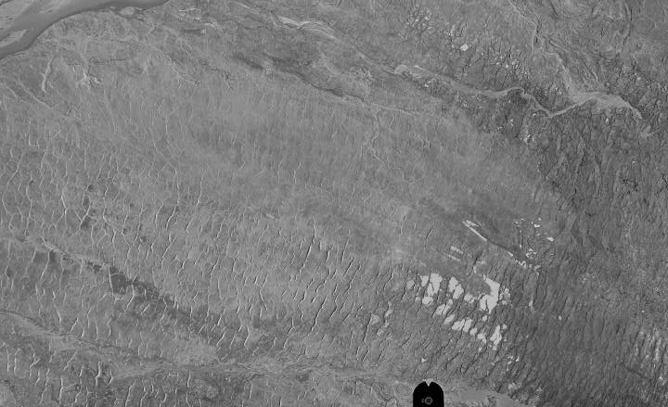
Process-form models:surging glaciers

Slide 19
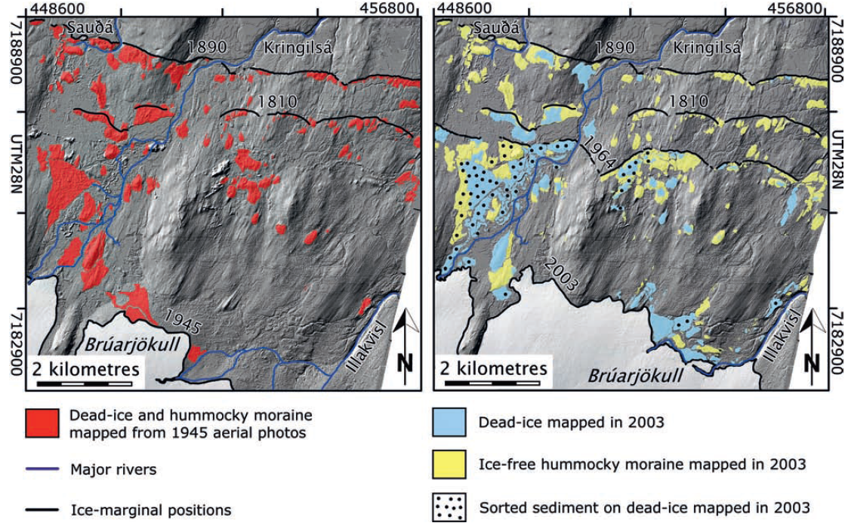
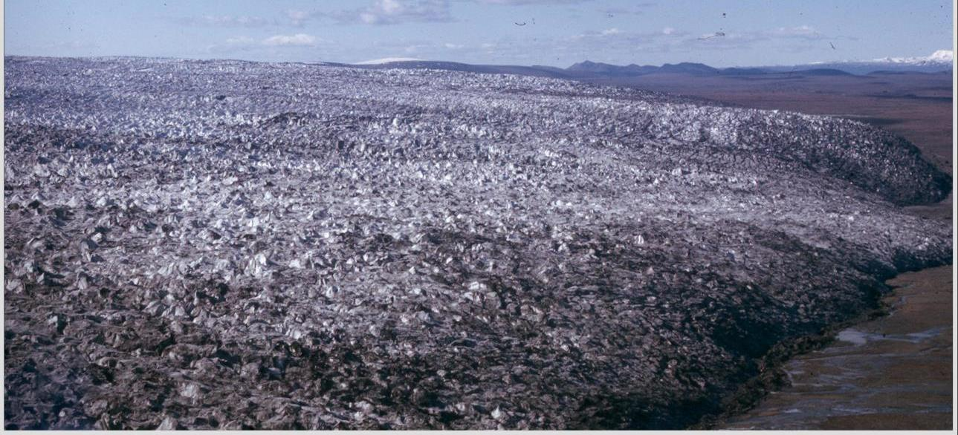


Process-form models: surging glaciers
Schomacker & Kjaer (2007) – spatial & temporal change at Brúarjökull
Benediktsson (2009)

Slide 20


Process-form models – modern analogues
Developing landsystem models - Snæfellsjökull ice cap centred landsystem
Little Ice Age polythermal glacier snout
– flutings extending to ice-cored moraine

Slide 21




Process-form models – modern analogues
Snæfellsjökull ice cap centred landsystem – a unique sediment/landform assemblage

Slide 22





Using UAVs – charting recent landform development at Fláajökull

Slide 23



Flutings, till eskers & CSRs
Flaajokull – developing our ideas on crevasse infills & till eskers from Sandfellsjokull
Flaajökull – arcuate assemblages of overridden moraines and recessional push moraines + crevasse infills & related “till eskers”

Slide 24



Till esker-crevasse squeeze ridge continuum – its not all surge indicative
Spatial change in
sub-marginal
landform/sediment
assemblages
(due to change in foreland drainage characteristics)

Slide 25







Utilizing modern satellite data – Kumtor Gold Mine

Slide 26

Utilizing modern satellite data – Kumtor Gold Mine
Digital Globe Foundation provided repeat satellite imagery from 1999-2014
Land element classification could be mapped as spatio-temporal continuum
Stagnant Lysii cirque glacier becomes remobilized by spoil dumping & then surges!

Slide 27


Utilizing modern satellite data – Kumtor Gold Mine
Davidov Glacier
- most of ablation
zone removed
- spoil dumped on
ice-cored moraine
in lower valley
Re-mobilization of ice-cored moraine as debris-covered glacier snout (permafrost creep & artificial glacial apron entrainment)
Construction of first reported human made proglacial thrust moraine!

Slide 28


Utilizing modern satellite data – Kumtor Gold Mine
Real time exercise in mapping glacial landsystem evolution & human modification (must be something for mining geology to learn here? – but do they care?)

Slide 29




Glacial landsystems – why bother?
Each landsystem is a representation of a glacial signature that is tuned to: glacier morphology, glacier thermal regime, glaciation style, local to regional climate regime, latitude, altitude etc.
Landsystems treat landforms and sediments as associations in a holistic framework – therefore we don’t treat landforms in isolation
Landsystems allow us to appreciate that the glacial landform/landscape legacy is a product of a spatial-temporal continuum – hence we can build up a family of landsystems suitable to the vast array of real world glacial signatures
Surging
Ice stream
Active temperate
Plateau
Sub-polar
Mountain valley

Slide 30

Quaternary glacial geology – Landsystem applications
Spatial/temporal overprinting in the SW Laurentide Ice Sheet

Slide 31


Spatial/temporal overprinting in the SW Laurentide Ice Sheet
Recessional push moraines = active temperate ice margins
Curvilinear hummock chains & ice-walled lake plains
= controlled moraine & polythermal ice margins

Slide 32





Slide 33




Spatial/temporal overprinting in the SW Laurentide Ice Sheet
Switching polythermal & active temperate conditions change to surge lobes in northern Alberta

Slide 34





Spatial/temporal overprinting in the SW Laurentide Ice Sheet
SW Laurentide
Ice Sheet margin
switching:
- active temperate/
polythermal margins
+ late stage
surging activity
Crevasse squeeze ridges
Thrust moraine
Recessional push moraines

Slide 35




Quaternary glacial geology: Embracing the complexity of glacifluvial landforms (Brampton kame belt, N England)
Glacier karst

Slide 36



Quaternary glacial geology: Embracing the complexity of glacifluvial landforms (Brampton kame belt, N England)
Modern analogue = Kame terraces, Sandfellsjokull, Iceland

Slide 37


Quaternary glacial geology: Embracing the complexity of glacifluvial landforms (Brampton kame belt, N England)
Modern analogues = englacial eskers at Virkisjökull & Kvíárjökull, Iceland

Slide 38
The status of Quaternary Domains – time to surpass Canadian Quaternary geology
(Booth et al. 2015)

Slide 39
New landsystem-based classification scheme for domains
(and type localities) – UK based approach
Ice sheet related landsystems = 1a: Subglacial footprint; 1b: Ice-marginal complexes;
1c: Supraglacial debris complexes
Typical ground models – 1a: Eden Valley/Solway Lowlands; Moray Firth; Vale of York;
Tweed lowlands; 1b: Eastern England; East Anglia; Irish Sea Basin; Chalk downlands;
Thames basin; 1c: Orrisdale outwash member, Isle of Man
2) Upland glacial landsystems/hard bedrock terrain = 2a: Subglacial footprint; 2b: Ice-marginal
complexes; 2c: Supraglacial debris complexes
Typical ground models – Ice sheet recessional settings/topographically-constrained
ice flow = west Scotland; Pennines; Mountain icefields = South Loch Lomond; Skye;
NW Highlands; SW Lake District; Smaller mountain glaciers = Brecon Beacons;
Applecross; Skye; Snowdonia
3) Glacifluvial sediment-landform associations = 3a: Ice-contact settings; 3b: Proglacial settings
Typical ground models - Brampton kame belt; Lleyn Peninsula; Strathallan; Carstairs
4) Subaqueous glacial depositional sequences = 4a: Ice-proximal depo-centres; 4b: Distal
sediment piles
Typical ground models - Rhosesmor and Wrexham deltas; Achnasheen; NW Britain
continental shelf; Waterville, Ireland

Slide 40

Thanks – and remember, the devil is in the detail!

